Slide 1

Cloud DevOps
Project capstone
Nozim Khodjaev
February 8, 2021

Slide 2
agenda
• What is the “Project Capstone” and its the purpose?
• What technology will be utilized to make this project successful?
• Step-by-step walkthrough
• Obstacles and Problems: What was done and what is still not achieved?
• Q&A

Slide 3
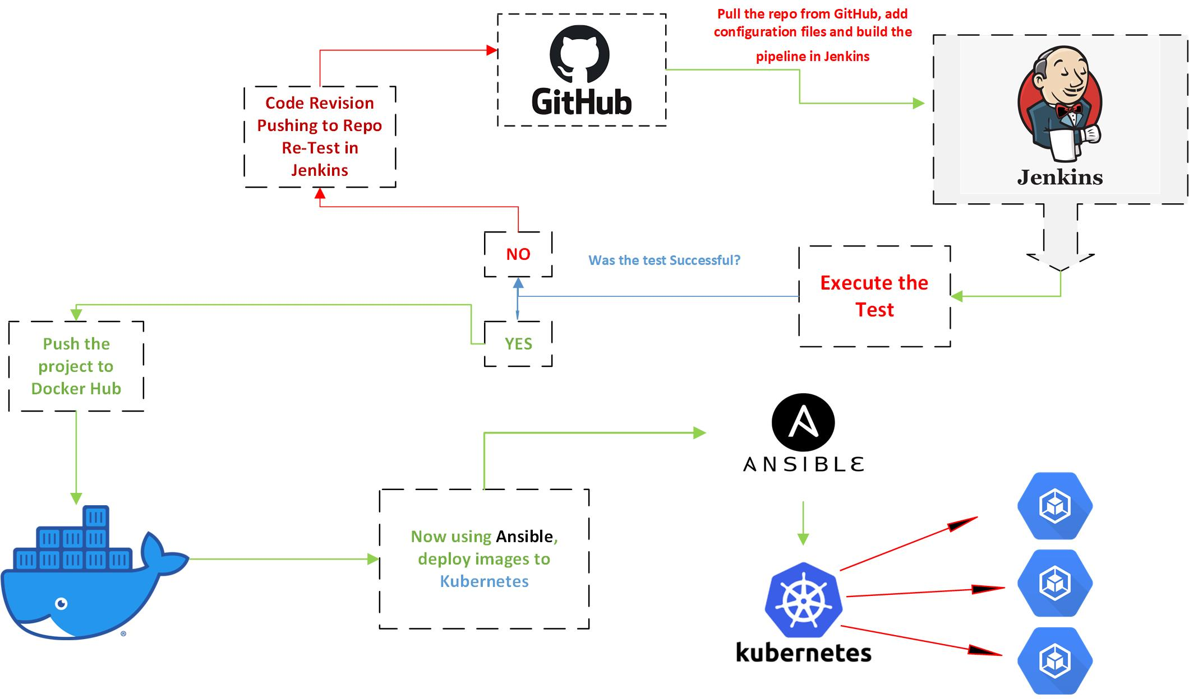

Slide 4




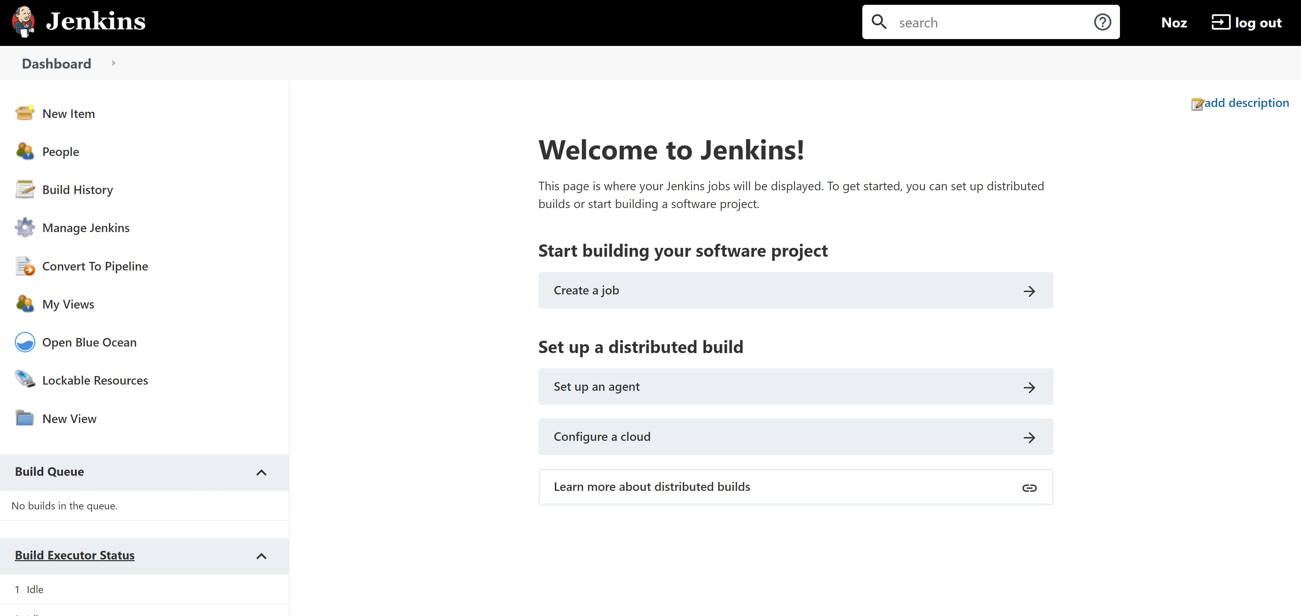

Slide 5
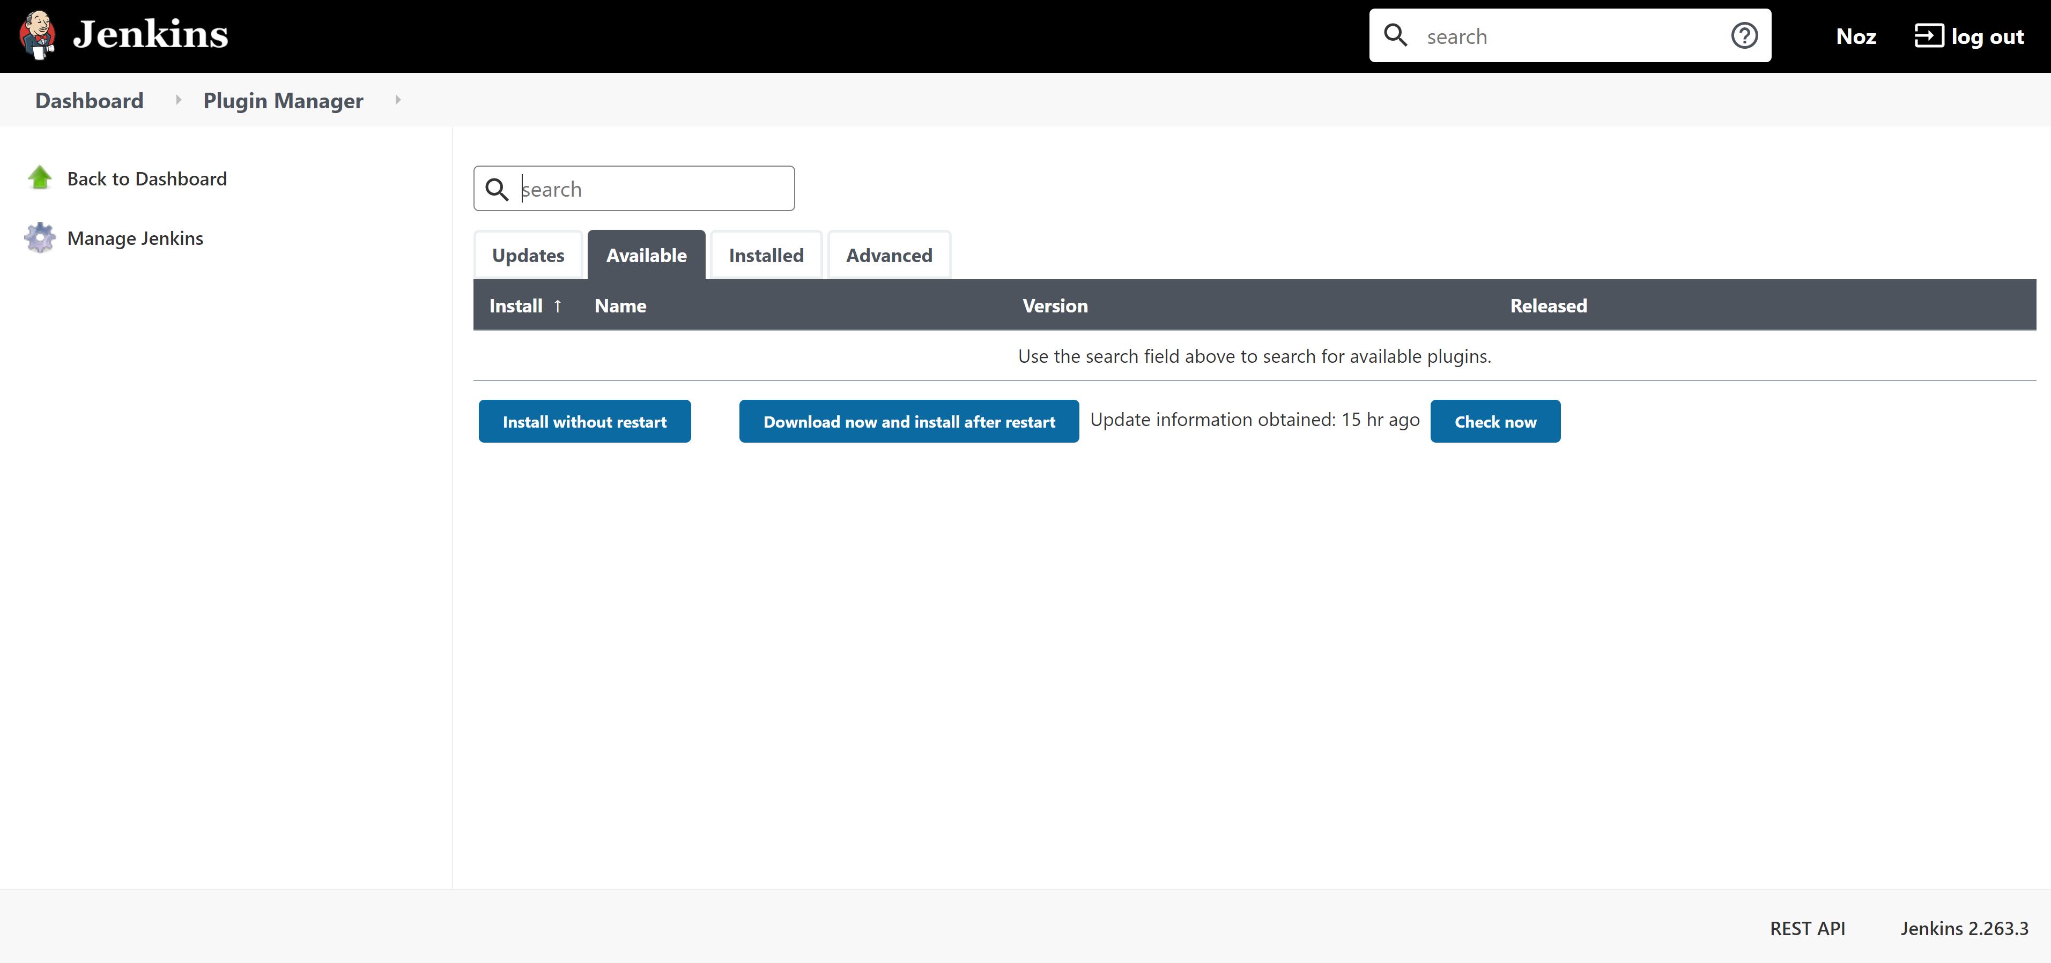
MUST INSTALL FOLLOWING PLUGINS
• Ansible
• Convert To Pipeline
• Docker
• Docker Pipeline
• CloudBees Docker Custom Build Environment
• Python
• Shining Panda

Slide 6
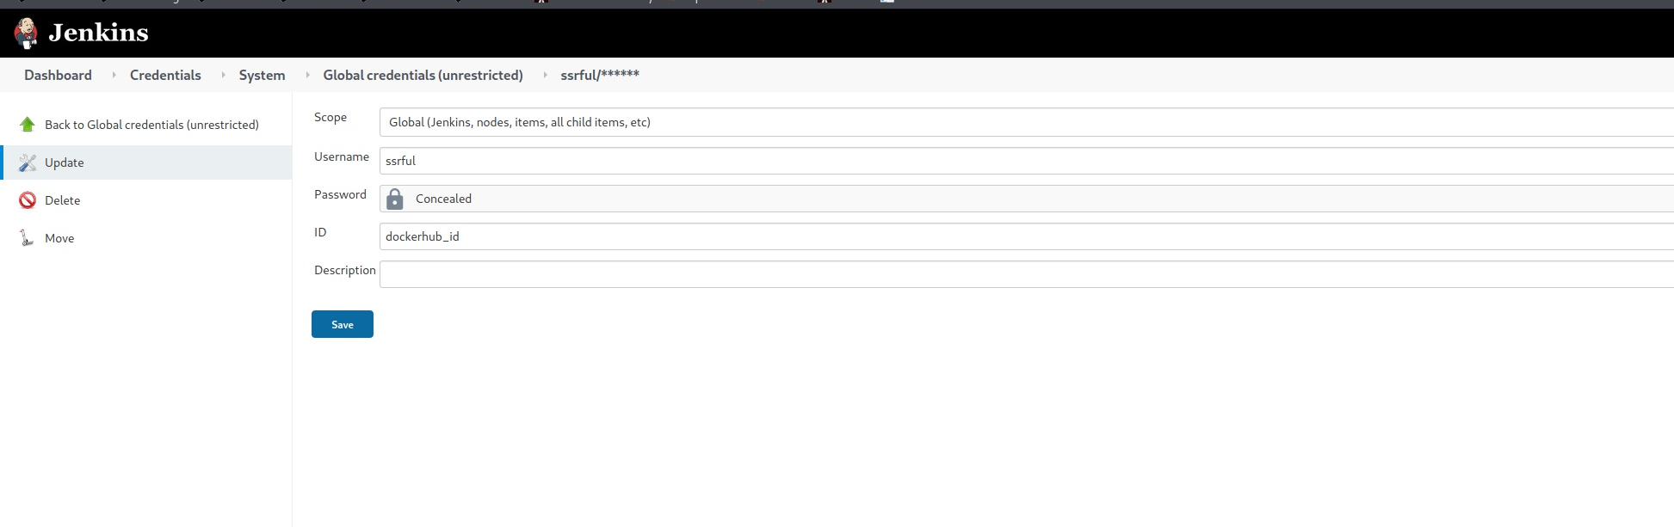
Docker Hub Credentials Required

Slide 7
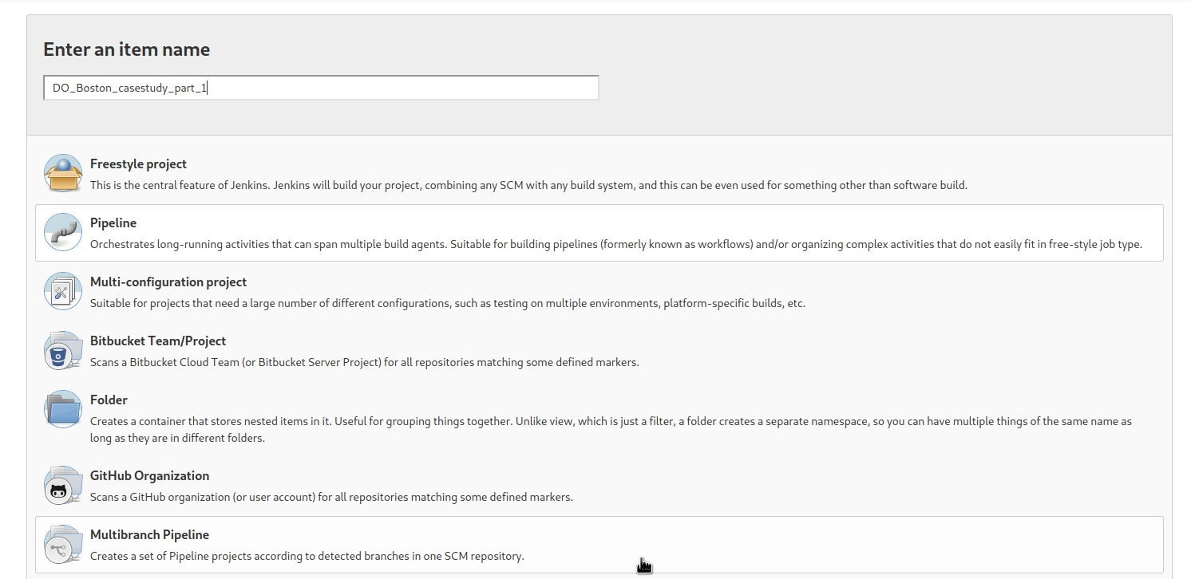
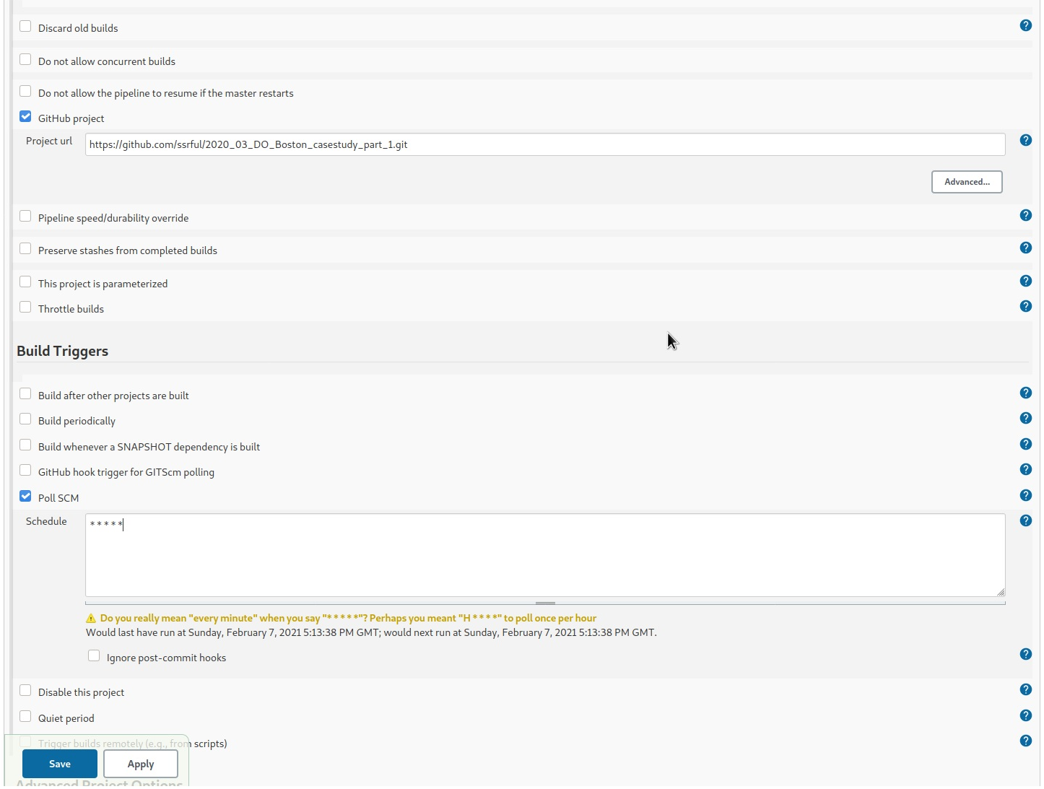
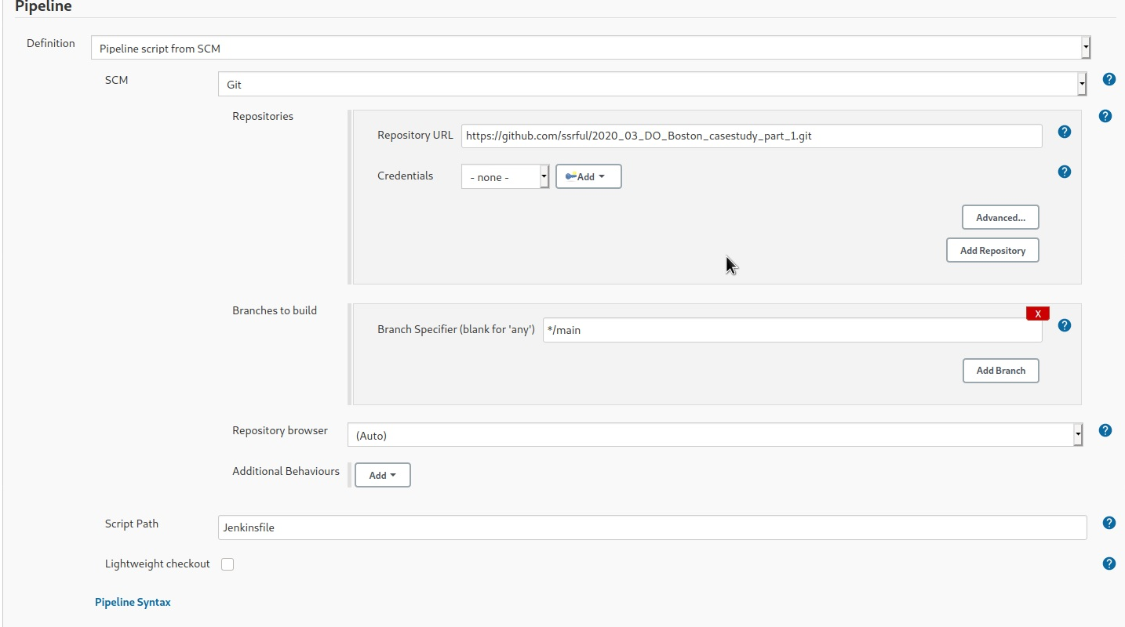


Slide 8
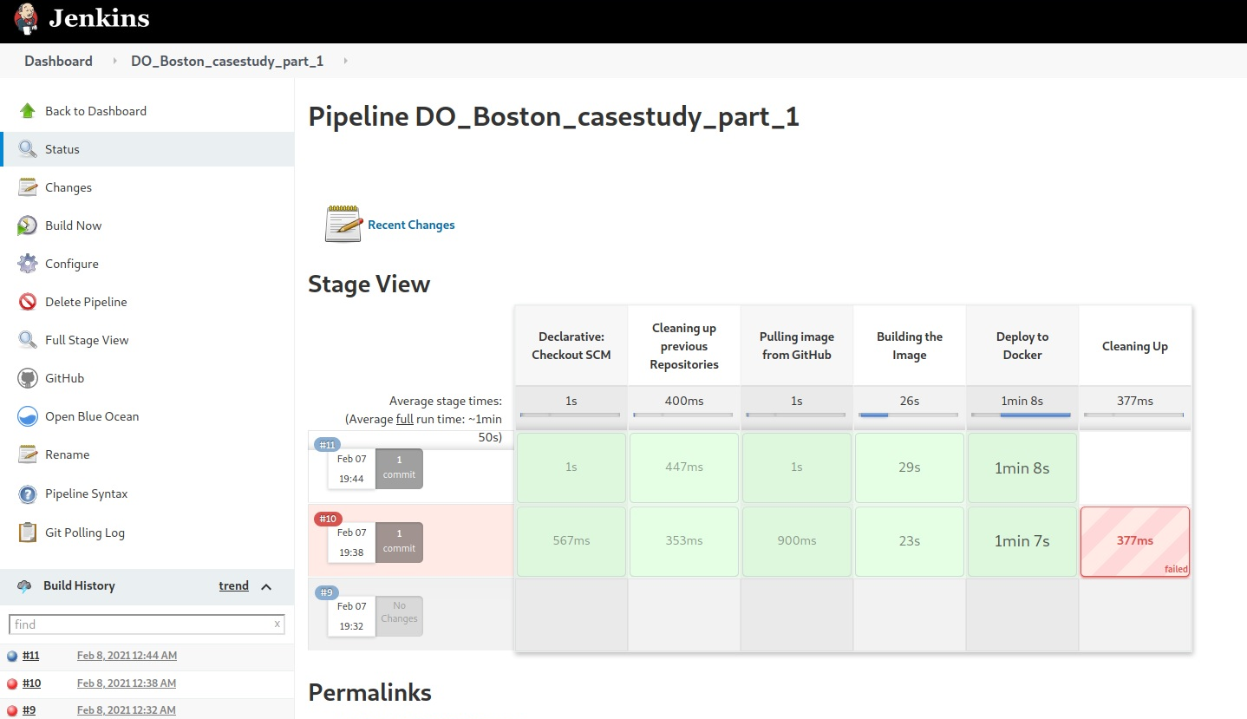
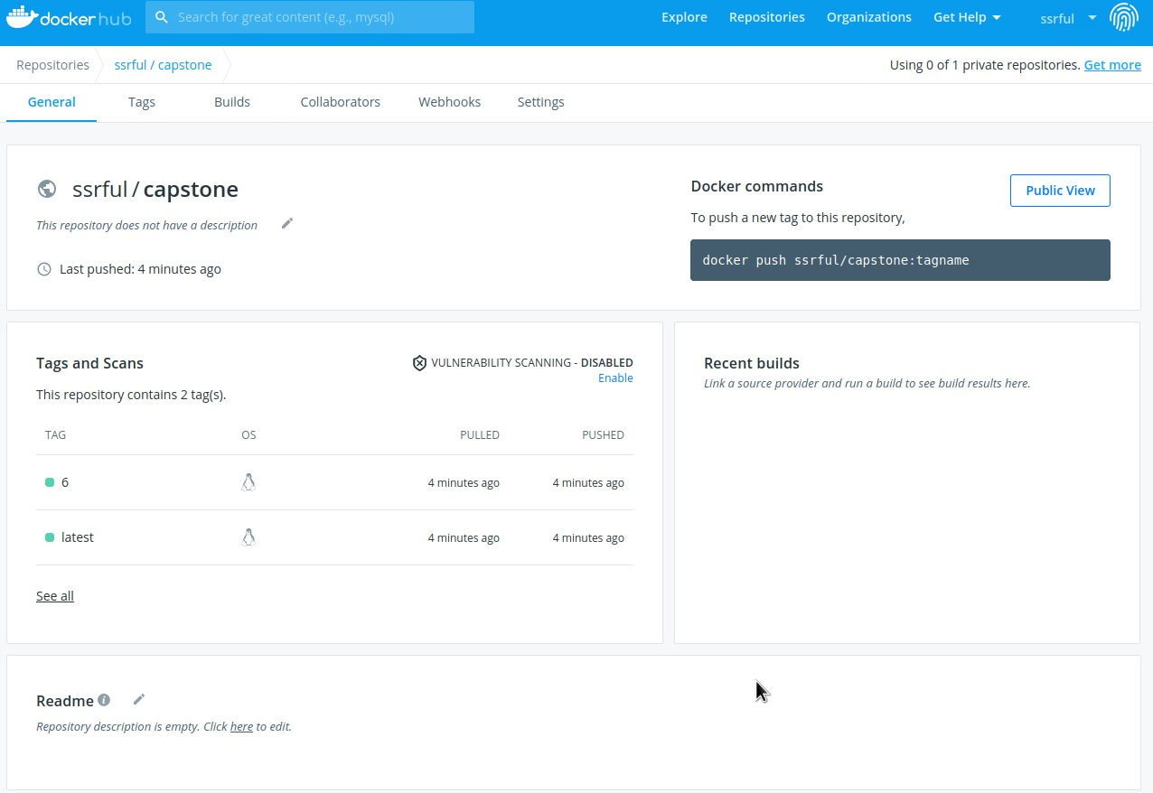

Slide 9
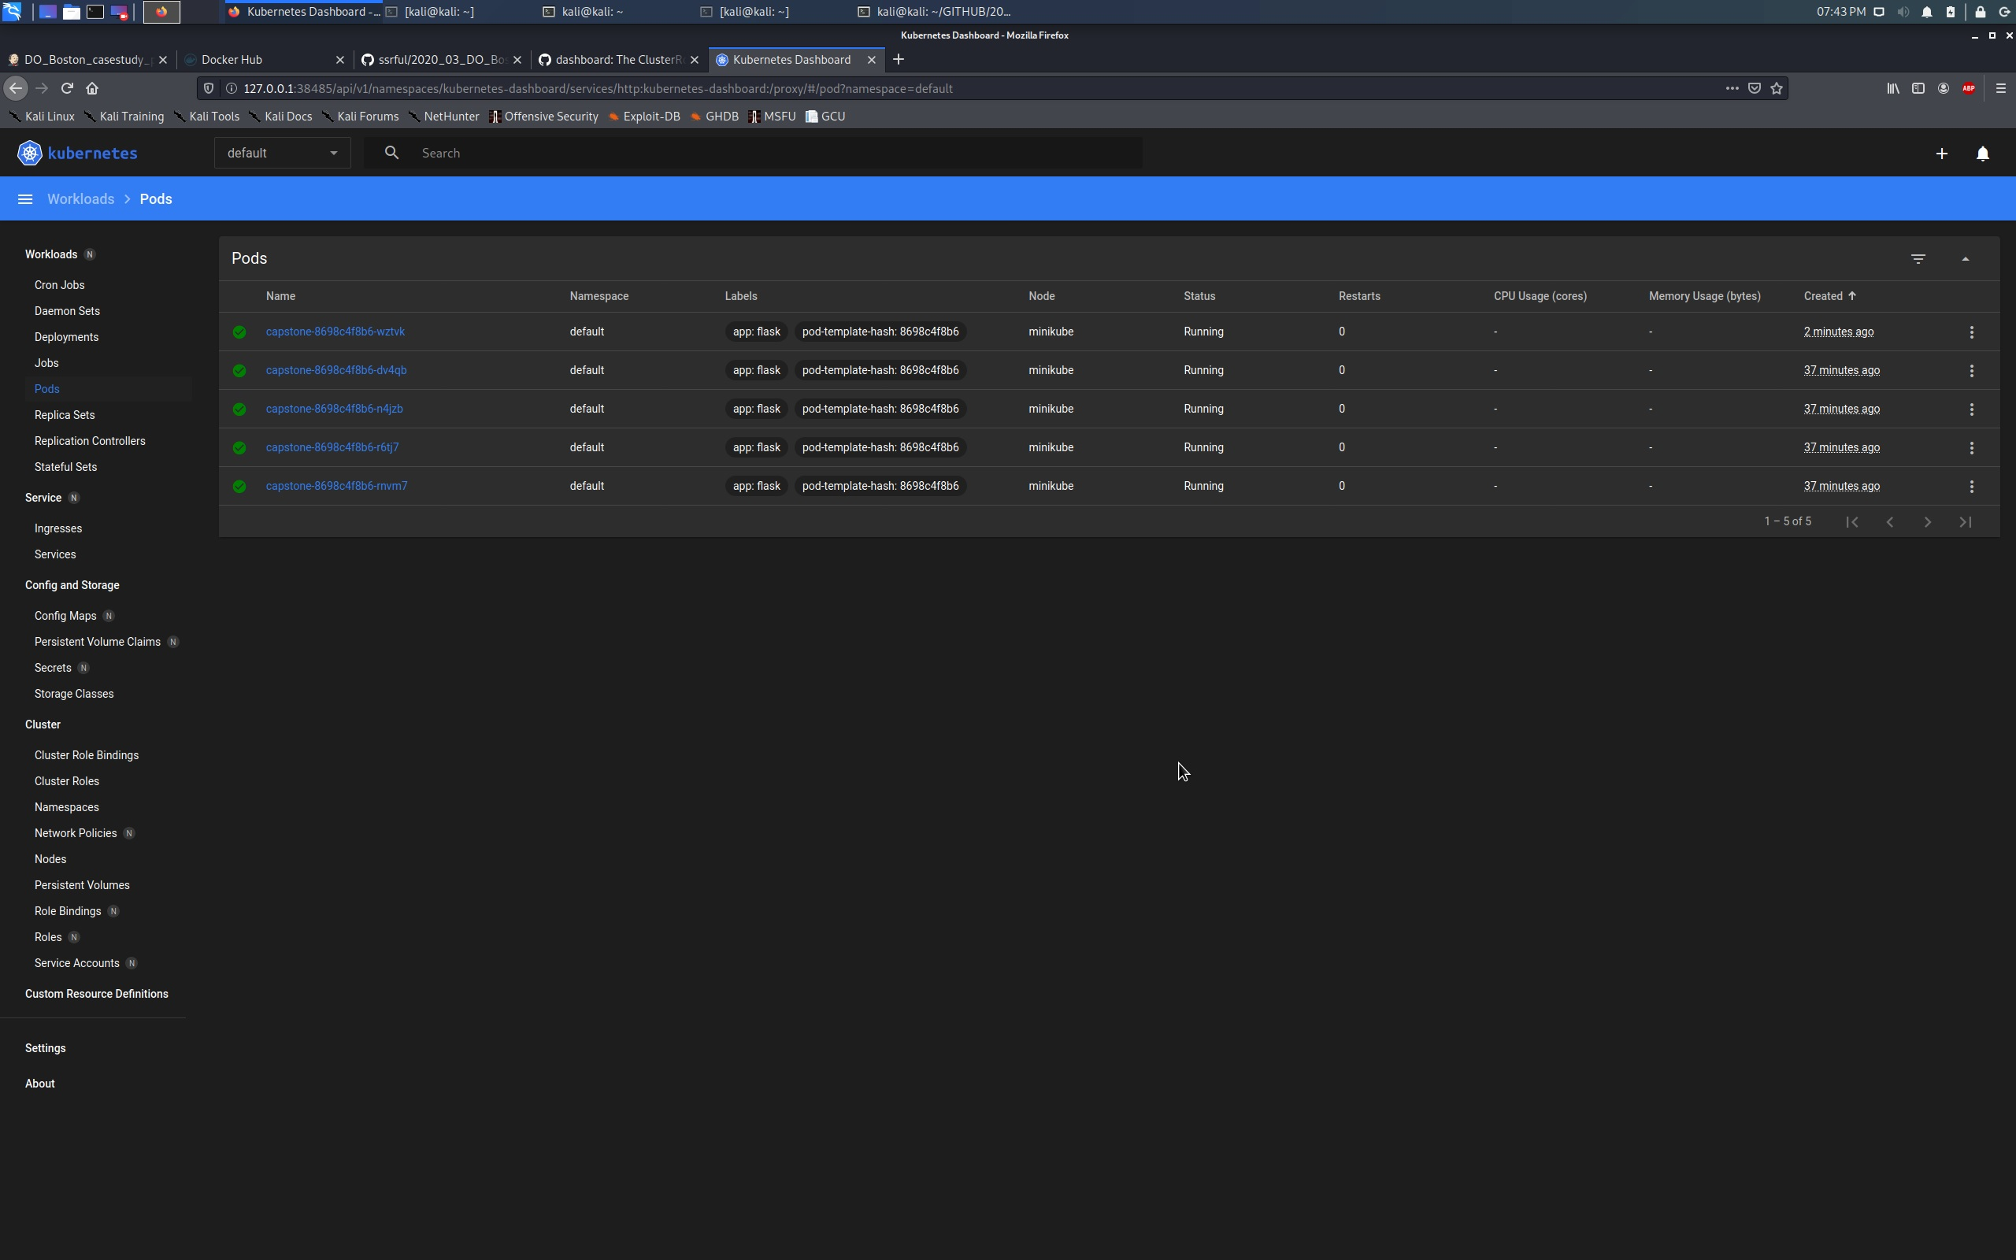
Kubernetes running on vm with 5 pods

Slide 10
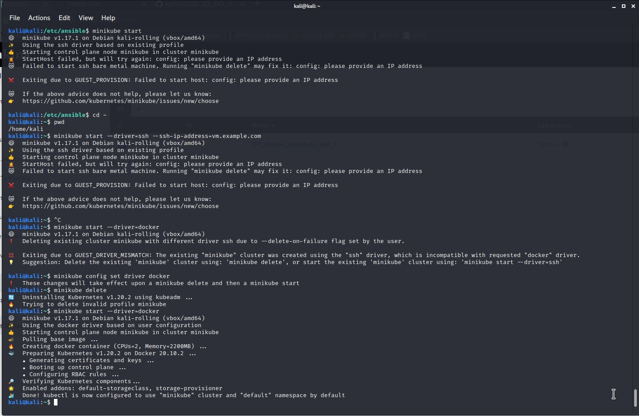
Obstacles and problems

Slide 11
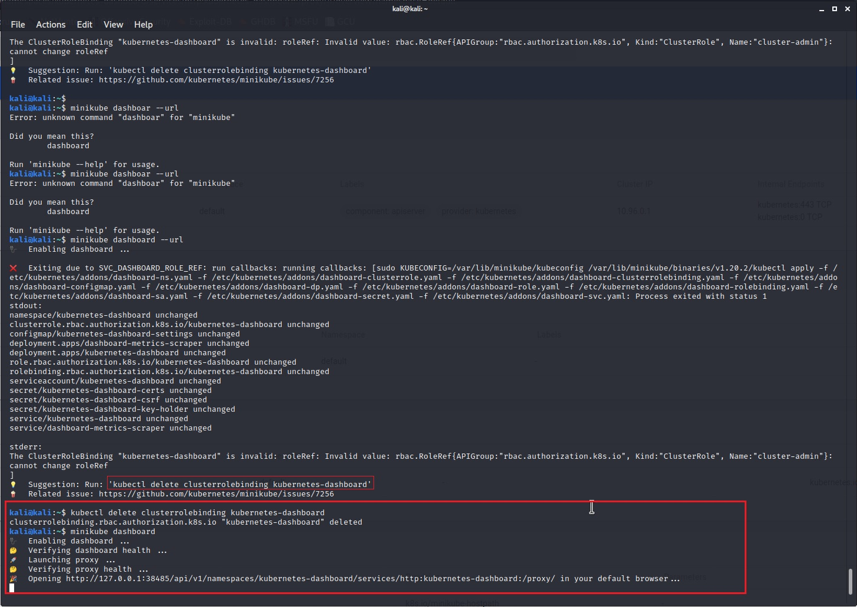
Obstacles and problems

Slide 12
Questions ?
Or any suggestions ?

Slide 13
Thank you for your attention

